Slide 1
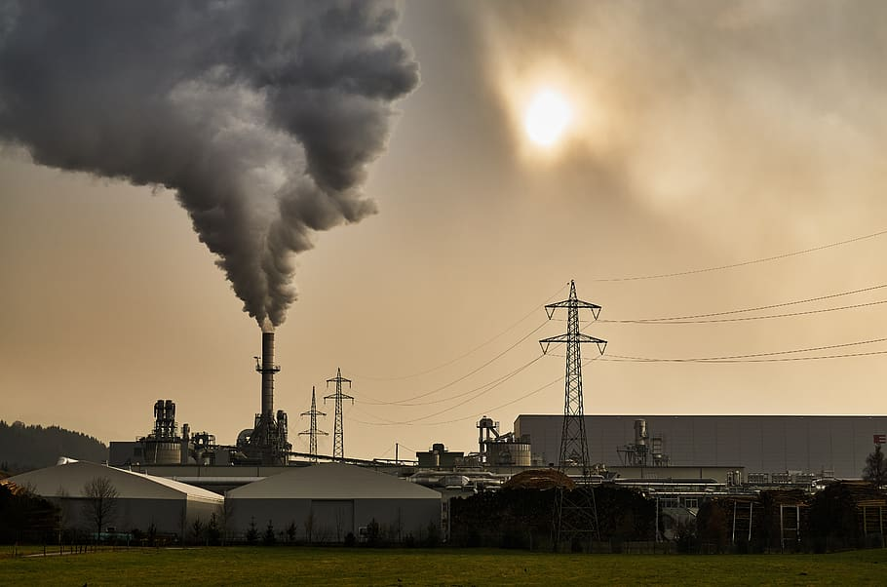
STATISTICAL ANALYSIS OF AIR QUALITY DATA AND
STUDY OF ITS EFFECT ON AIR POLLUTION
IN WEST BENGAL
PRESENTING BY –SUBRATA SAHU
ROLL NO--- BSC(SEM-VI)STAT -14
DEPARTMENT OF STATISTICS
VISVA BHARATI UNIVERSITY
PAPER :DSE-4
1

Slide 2
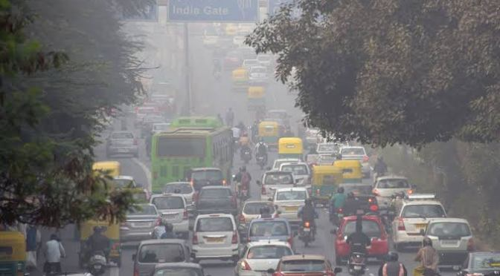
Contents
serial no.
1. | Introduction
2. | Description of data
3. | Objectives
4. | Methodology
5. | Data Analysis and Interpretation
6. | Conclusion
7. | Reference
8. | Appendix
2

Slide 3
Introduction
What is Air Pollution?
Air pollution refers to any physical, chemical or biological change in the air. It is the contamination of air by harmful gases, dust and smoke which affects plants, animals and humans drastically.
Air pollution is one of the major and serious problems in all over the world. Air gets polluted mainly by artificial and natural sources. Polluted air contains gases, dust, fumes and other harmful materials present in it. Air pollution problems is higher in these days when compare to last 50 years back.
There is a certain percentage of gases present in the atmosphere. An increase or decrease in the composition of these gases is harmful to survival. This imbalance in the gaseous composition has resulted in an increase in earth’s temperature, which is known as global warming.
West Bengal has the highest air pollution related deaths among states in the mid socio demographic index (SDI) segment according to a report published by Centre for Science and Environment (CSE), a Delhi based public interest research organization.
3

Slide 4
DESCRIPTION OF DATA
Data is collected on the various contents in air viz. Sulphur dioxide (SO₂), nitrogen dioxide (NO₂), RSPM and SPM in different locations of West Bengal over the years from 2005 to 2015. The locations are Asansol, Barrackpore, Haripur, Kolkata, Dankuni, Durgapur, Haldia, Howrah, Rani Ganj, sank rail, South Suburban, Kalyani, Maldah, Siliguri and Ulu Beria, each of which is classified into four types of areas viz. Industrial areas, Residential and other areas, Residential, Rural and other areas and RIROU areas. A part of the raw data is given in the appendix later.
:
4

Slide 5
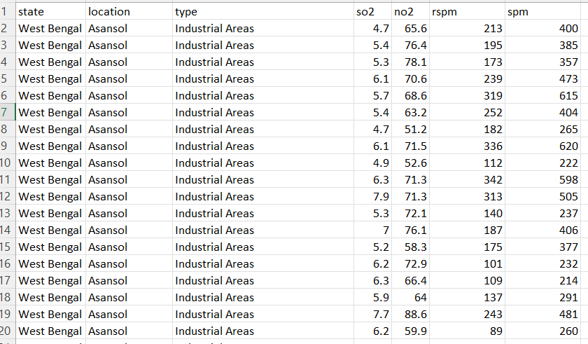
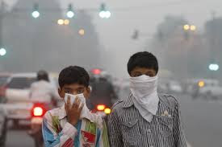
Data Description
The data is collected from the website www.kaggle.com
5

Slide 6
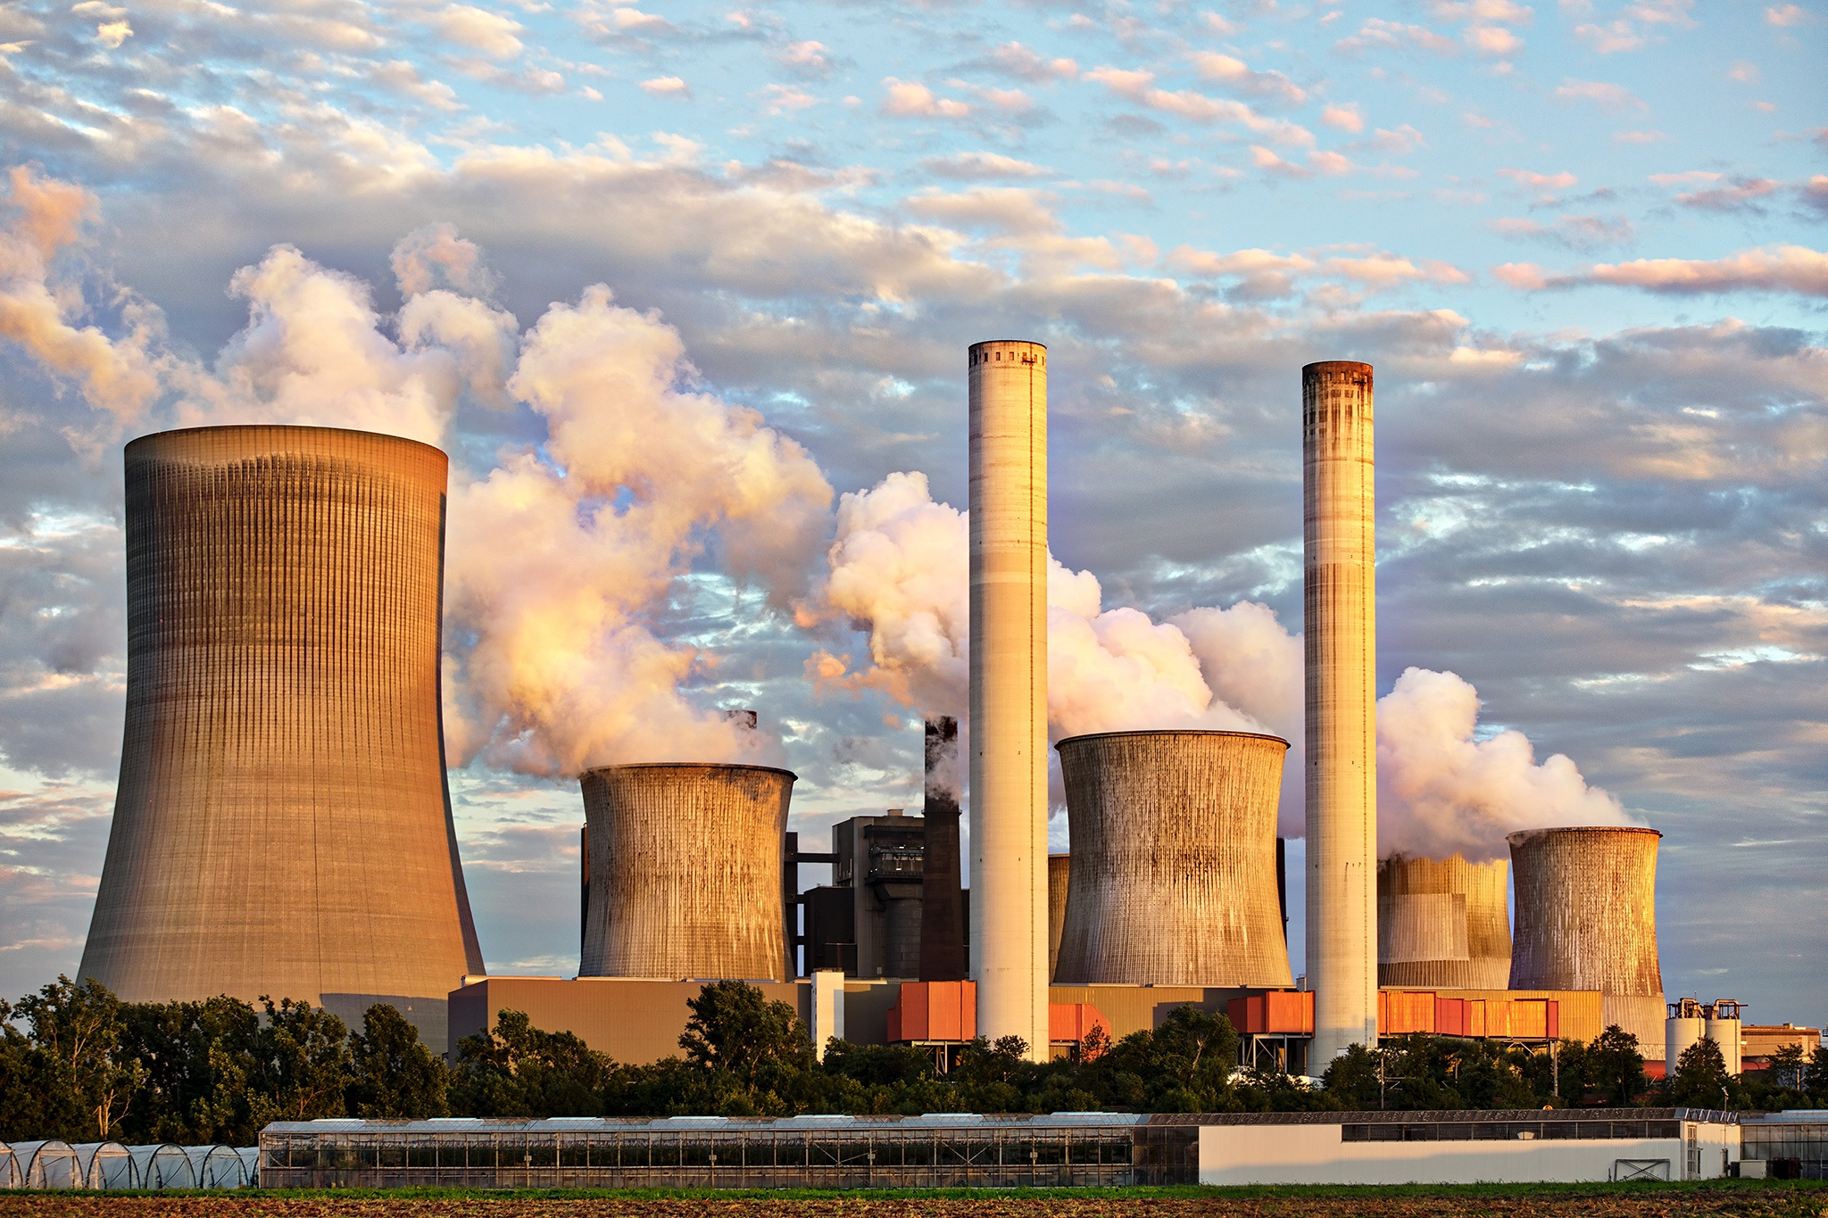
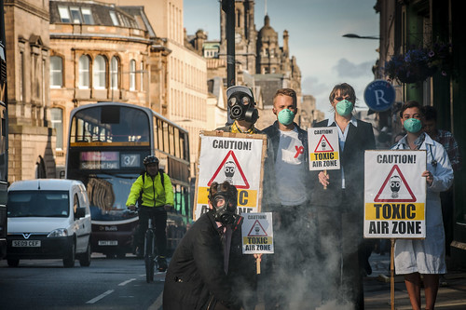
OBJECTIVES
Our main objectives are: -
1) Compare the average SO₂, NO_{2,} RSPM, SPM content in air location wise and between types of locations in West Bengal (2005-2015) through diagrammatic representation.
2) Compare the average SO₂, NO_{2,} RSPM, SPM content in air between years and between types of locations in West Bengal through diagrammatic representation.
3) Perform a two-way analysis of variance to test the significance of the locations and types of locations on the average Sulphur dioxide SO₂, NO_{2,} RSPM, SPM content in air.
4) Perform Welch Two Sample t-test.

Slide 7
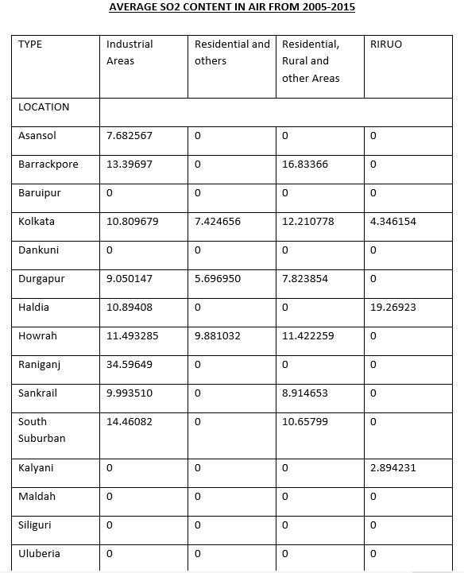
METHODOLOGY
Definition of Mean in Statistics
Mean is the average of the given numbers and is calculated by dividing the sum of given numbers by the total number of numbers.
Mean = (Sum of all the observations/Total number of observations)
Mean Symbol (X Bar)
The symbol of mean is usually given by the symbol ‘x̄’. The bar above the letter x, represents the mean of x number of values.
X̄ = (Sum of values ÷ Number of values)
X̄ = (x₁ + x₂ + x₃ +…. +x_{n})/n

Slide 8
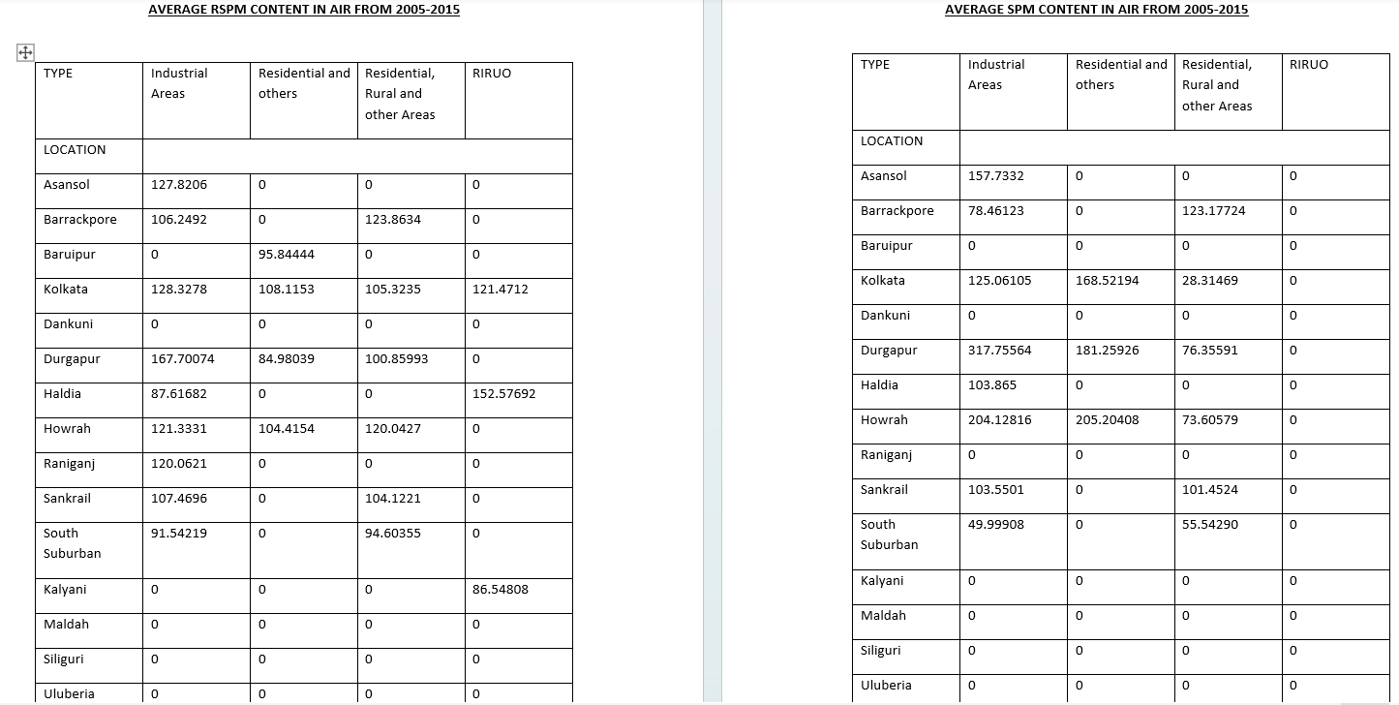

Slide 9
GRAPHICAL REPRESENTATION: (a)Bar plot
The divided bar plot between location and types of locations/year.
Interpretation: From the above bar diagram, it can be noted that the average SO₂ content in air is mostly maximum in industrial areas as compared to residential and other areas. Also, it can be observed that the industrial areas of Rani Ganj has the highest average SO₂ content in air.
Fig no:1
9

Slide 10
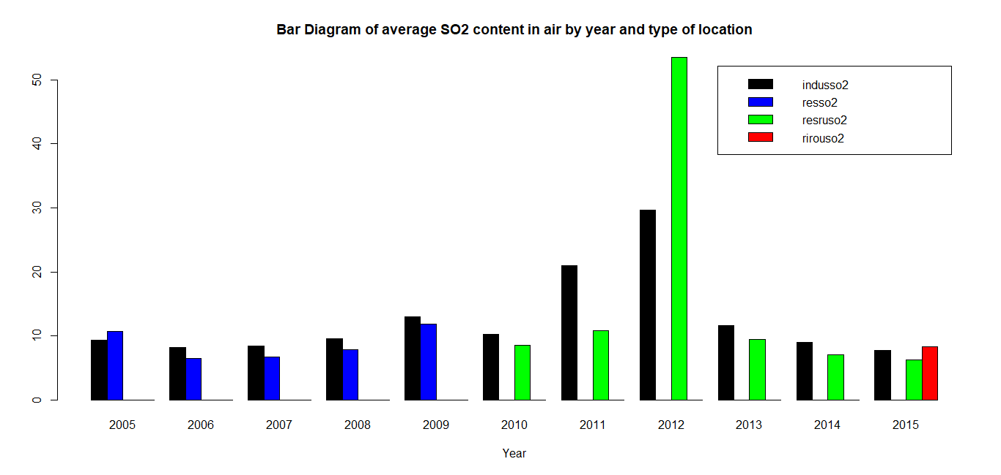
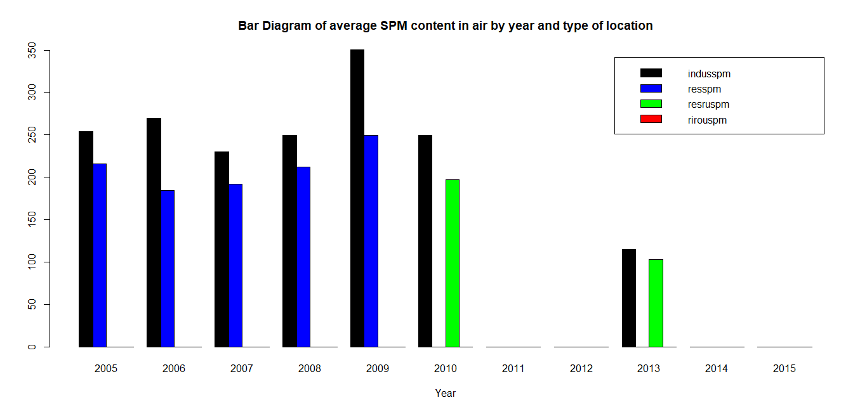
Interpretation: From the above bar diagram, it can be noted that the average SO₂ content in air is higher in industrial areas than residential and other areas for most of the years except for 2012 when it is higher in residential, rural and other areas than industrial areas.
Interpretation: From the above bar diagram, it can be noted that the average SPM content in air is higher in industrial areas than residential and other areas for all the years from 2005 to 2015.
Fig no:3
Fig no:4
10

Slide 11
Interpretation: From the above bar diagram, it can be noted that Durgapur has the highest average SPM content in air in its industrial areas. Kolkata has higher SPM content in air in its residential and other areas than its industrial areas. Also Barrackpore has higher SPM content in air in its residential, rural and other areas than its industrial areas.
Interpretation: From the above bar diagram, it can be noted that the average RSPM content in air is mostly maximum in industrial areas as compared to residential and other areas. But Haldia has higher RSPM content in air in its RIROU areas than industrial areas. Also it can be observed that Durgapur has the highest average RSPM content in air in its industrial areas.
Fig no:5
Fig no:6

Slide 12
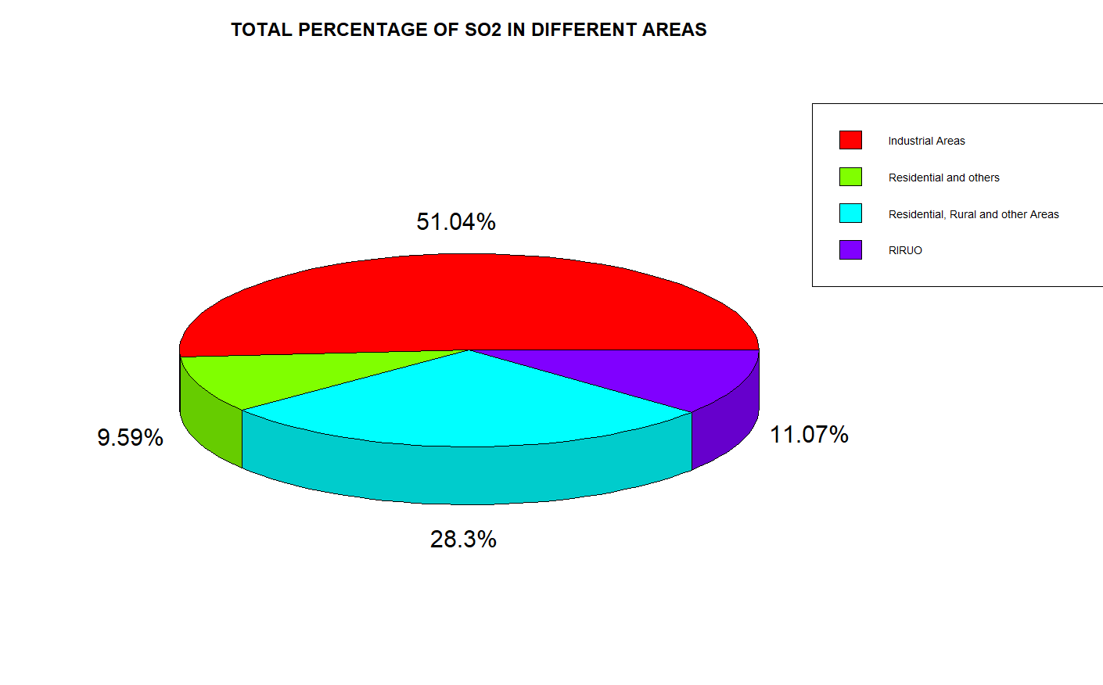
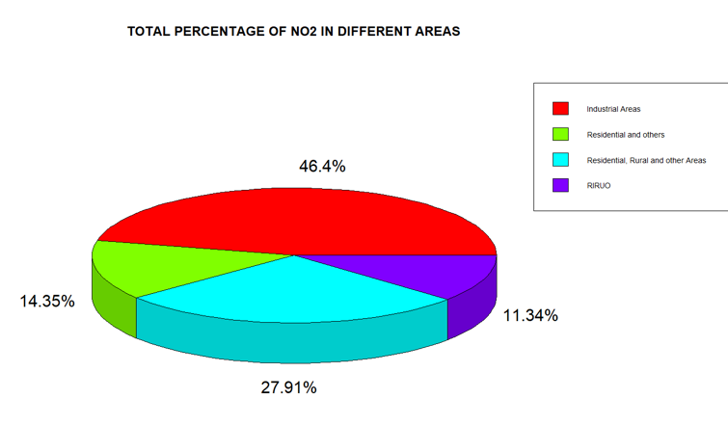
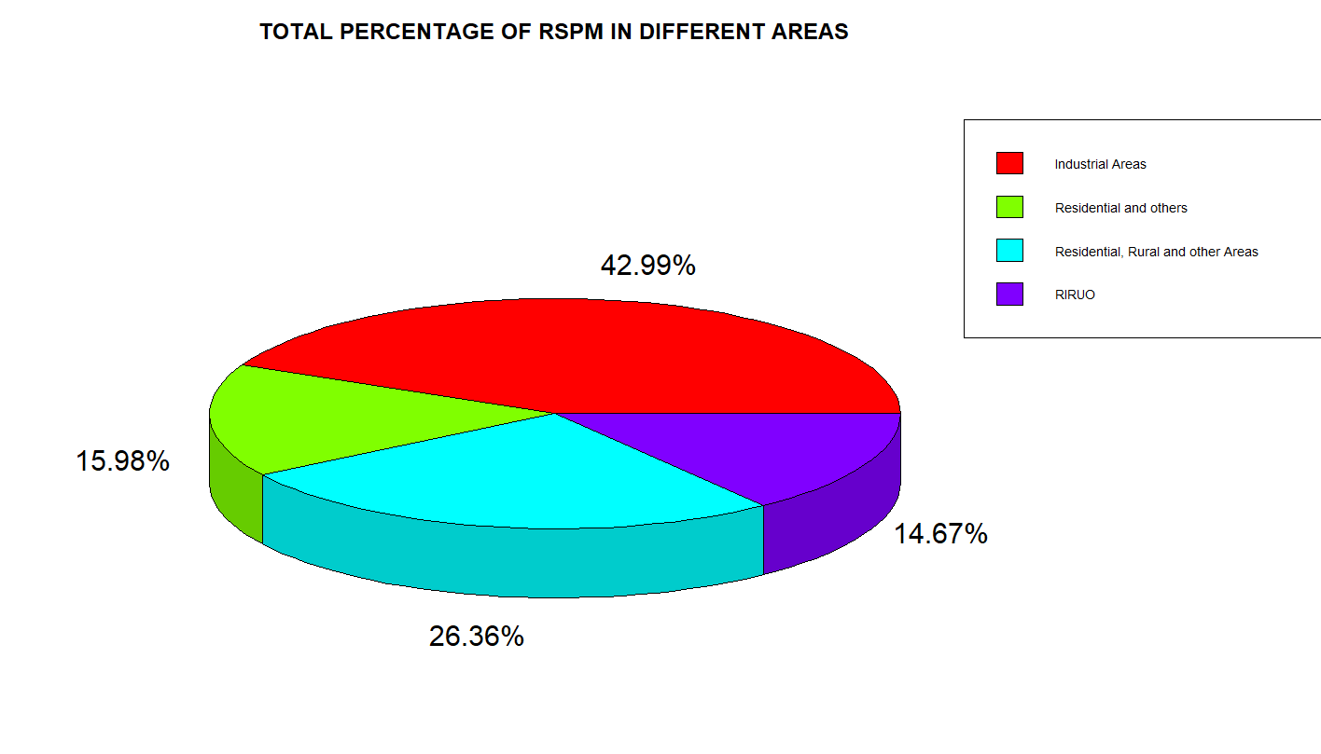
(b)PIE CHART
SO₂, NO_{2,} RSPM, SPM IN DIFFERENT AREAS(PERCENTAGE):
12

Slide 13
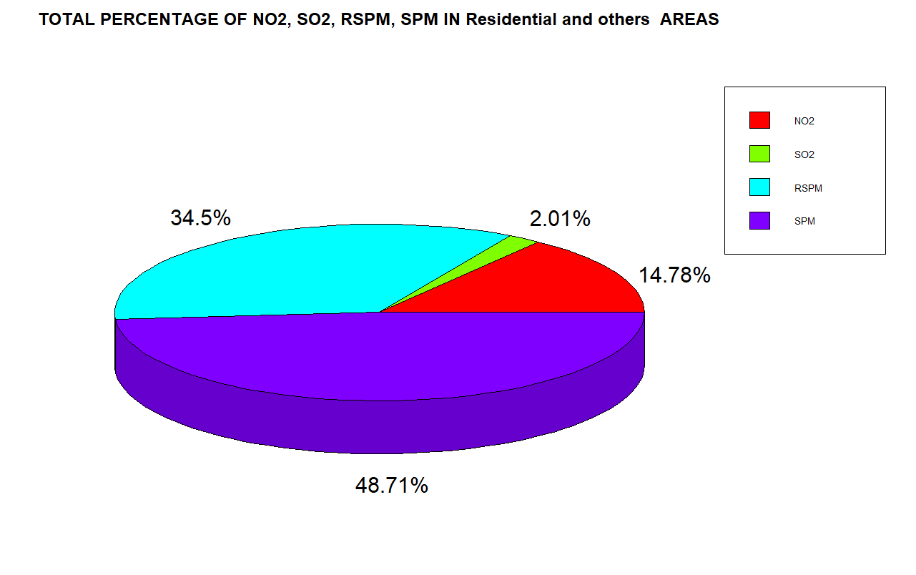
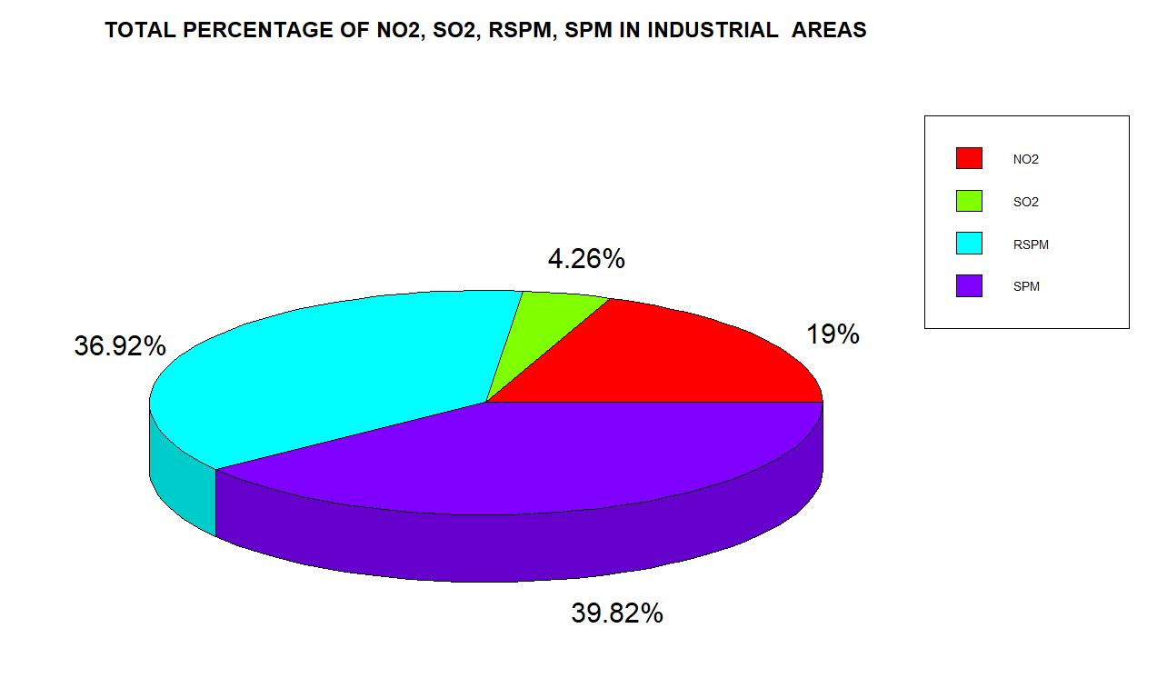
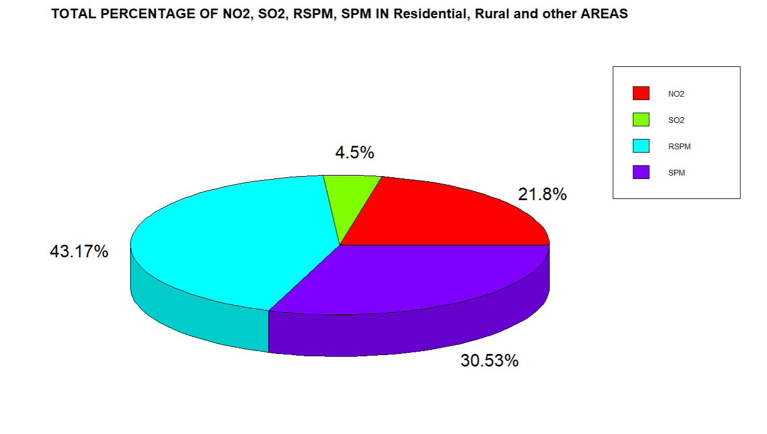
1)DIFFERENT AIR PARTICALS IN DIFFERENT AREAS(PERCENTAGE):
13

Slide 14
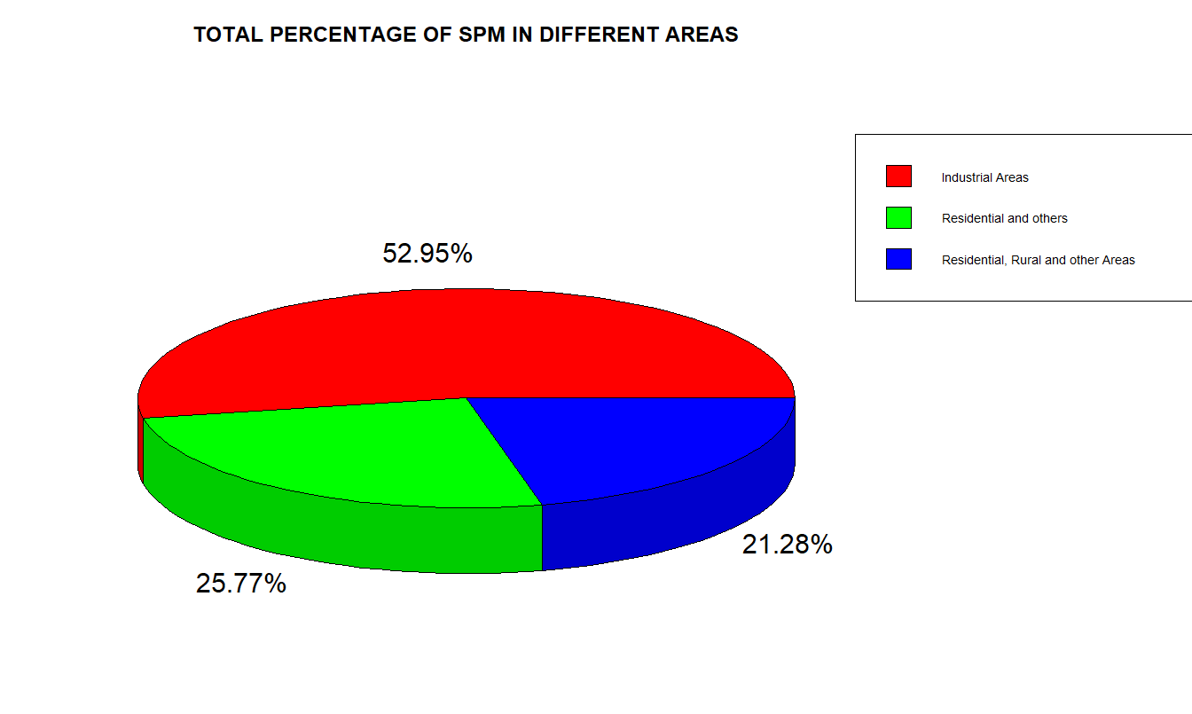
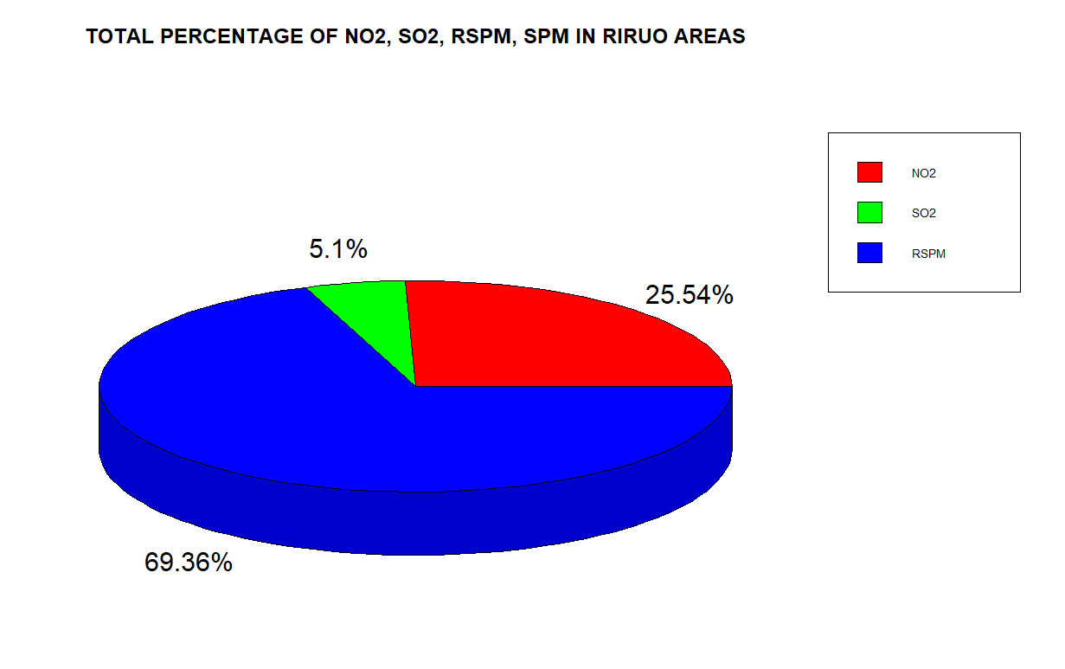
Fig no:07
Fig no:08
14

Slide 15
ANALYSIS AND INTERPRETATION
Now a two-way analysis of variance is carried out for the average SO₂, NO_{2,} RSPM, SPM content in air taking the two factors as location and type of location using R software as follows:
This is actually two way classified data with one observation per cell .
15

Slide 16
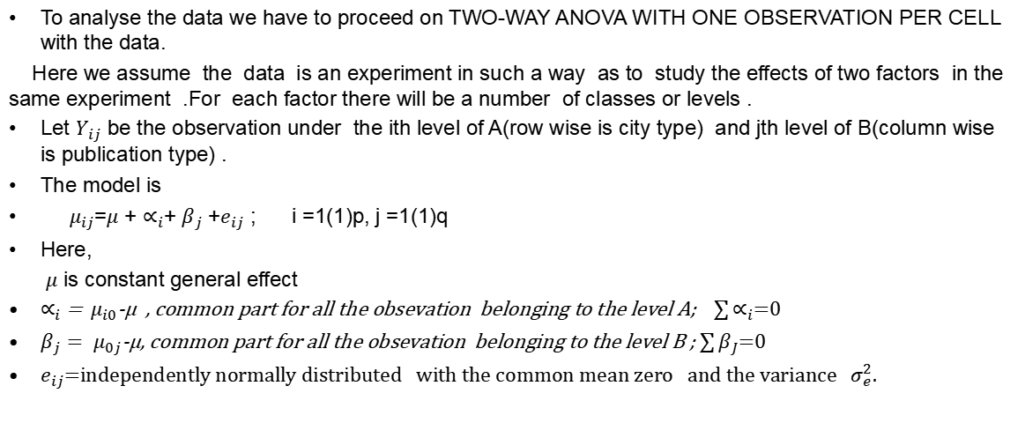
METHOD AND MATERIALS
16

Slide 17
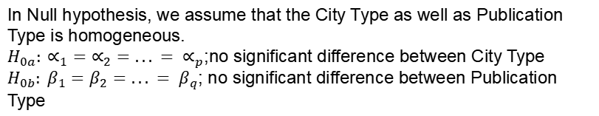



HYPOTHESIS TESTING :
NULL HYPOTHESIS
ALTERNATIVE HYPOTHESIS
17

Slide 18
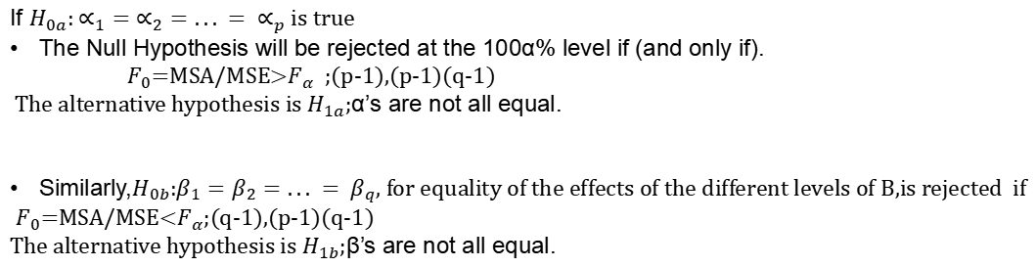
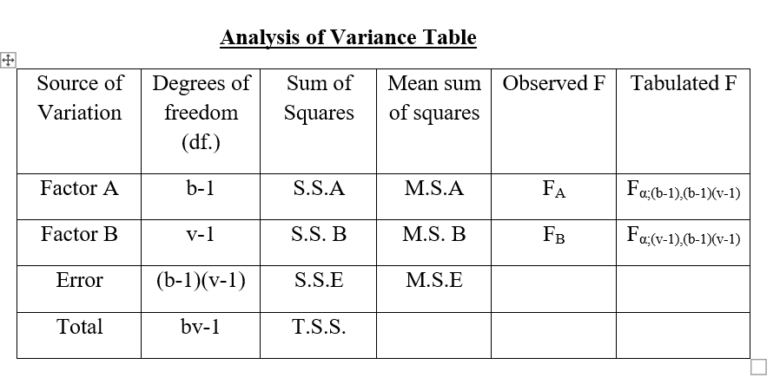
TEST STATISTICS
18

Slide 19
ANOVA TABLE FOR SO₂
Since the p-value for location is greater than 0.05, so we conclude that the average SO₂ content in air does not differ significantly between locations. But the p-value for type of location is less than 0.05 indicating that the average SO₂ content in air differs significantly between types of locations.
Source of Variation | DF | SS | MSS | Fobs | P-value | F critical
Location | 14 | 760.0 | 54.28 | 1.575 | 0.1271 | 1.9350
Type | 3 | 429.5 | 143.18 | 4.155 | 0.0115 | 2.827
Error | 42 | 1447.4 | 34.46
Total | 59 | 2636.9
Source of Variation | DF | SS | MSS | Fobs | P-value | F critical
Location | 14 | 20702 | 1478.7 | 3.666 | 0.000543 | 1.9350
Type | 3 | 7050 | 2349.9 | 5.826 | 0.002015 | 2.827
Error | 42 | 16942 | 403.4
Total | 59 | 44694
ANOVA TABLE FOR NO₂
Since the p-value for both location and type are less than 0.05, so we conclude that the average NO₂ content in air differs significantly both between locations and also between types of locations.
19

Slide 20
ANOVA TABLE FOR RSPM
Source of Variation | DF | SS | MSS | Fobs | P-value | F critical
Location | 14 | 73229 | 5231 | 2.458 | 0.0124 | 1.9350
Type | 3 | 20757 | 6919 | 3.251 | 0.0310 | 2.827
Error | 42 | 89377 | 2128
Total | 59 | 183363
Since the p-value for both location and type are less than 0.05, so we conclude that the average RSPM content in air differs significantly both between locations and also between types of locations.
ANOVA TABLE FOR SPM
Source of Variation | DF | SS | MSS | Fobs | P-value | F critical
Location | 14 | 122020 | 8716 | 3.211 | 0.00172 | 1.9350
Type | 3 | 43942 | 14647 | 5.397 | 0.00312 | 2.827
Error | 42 | 113997 | 2714
Total | 59 | 279959
Since the p-value for both location and type are less than 0.05, so we conclude that the average SPM content in air differs significantly both between locations and also between types of locations.
Table no:2
20

Slide 21
Welch Two Sample t-test for SO₂
t = 2.6173, df = 17.457, p-value = 0.01775
95 percent confidence interval:
1.295281 11.954707
sample estimates:
mean of x mean of y
8.158503 1.533509
Since the p-value is less than 0.05, so we conclude that the average SO₂ content in air differs significantly between industrial areas and residential and other areas.
t = 2.3546, df = 21.581,p-value = 0.02807 95 percent confidence interval:
0.7556062 12.0267849 sample estimates:
mean of x mean of y
8.158503 1.767308
Since the p-value is less than 0.05, so we conclude that the average SO₂ content in air differs significantly between industrial areas and RIROU areas.
21

Slide 22
Welch Two Sample t-test for NO₂
t = 2.8859, df = 22.506, p-value = 0.008454
95 percent confidence interval:
7.753515 47.173867
sample estimates:
mean of x mean of y
36.317857 8.854167
Since the p-value is less than 0.05, so we conclude that the average NO₂ content in air differs significantly between industrial areas and RIROU areas.
t = 2.4523, df = 25.781, p-value = 0.02128
95 percent confidence interval:
4.049506 46.115616
sample estimates:
mean of x mean of y
36.31786 11.23530
Since the p-value is less than 0.05, so we conclude that the average NO₂ content in air differs significantly between industrial areas and residential areas.
22

Slide 23
Welch Two Sample t-test for RSPM
t = 2.2291, df = 25.562, p-value = 0.0348295 95percent confidence interval:3.417467 85.218083 sample estimates
mean of x mean of y 70.54148 26.22370
Since the p-value is less than 0.05, so we conclude that the average RSPM content in air differs significantly between industrial areas and residential areas.
t = 2.2317, df = 27.009, p-value = 0.03413 95 percent confidence interval: 3.748638 89.254822 sample estimates:
mean of x mean of y
70.54148 24.03975
Since the p-value is less than 0.05, so we conclude that the average RSPM content in air differs significantly between industrial areas and RIROU areas.
23

Slide 24
Welch Two Sample t-test for SPM
t = 3.0968, df = 14, p-value = 0.007882 95 percent confidence interval: 23.37574 128.69805 sample estimates:
mean of x mean of y
76.0369 0.0000
Since the p-value is less than 0.05, so we conclude that the average SPM content in air differs significantly between industrial areas and RIROU areas.
t = 2.7162, df = 14, p-value = 0.01672
95 percent confidence interval:
6.429794 54.696730
sample estimates:
mean of x mean of y
30.56326 0.00000
Since the p-value is less than 0.05, so we conclude that the average SPM content in air differs significantly between residential, rural and other areas and RIROU areas.
24

Slide 25
1)The average content of sulphur dioxide (SO₂) in air differs significantly between types of locations but does not vary significantly between the various locations of West Bengal. It differs significantly between industrial areas and residential areas and also between industrial and RIROU areas. From the bar diagrams, Raniganj is observed to have the highest average SO₂ content in air which maybe due to a large number of industries present there. In 2012, average SO₂ content was much lower in industrial areas than residential and other areas which maybe due to shutdown of some factories or recession. Hence sulphur dioxide (SO₂) can be considered as a major air pollutant mostly in industrial areas due to various industrial productions.
CONCLUSION
2)The average content of nitrogen dioxide (NO₂) in air differs significantly both between types of locations and also between the various locations of West Bengal. It differs significantly between industrial areas and residential areas and also between industrial and RIROU areas. From the bar diagrams, it is observed that industrial areas of Howrah have the highest average NO₂ content in air. The average NO₂ content remains higher in industrial areas throughout all the years from 2005 to 2015. Hence nitrogen dioxide (NO₂) can also be considered as a major air pollutant mostly in industrial areas due to various industrial productions

Slide 26
CONCLUSION
4)The average content of SPM in air differs significantly both between types of locations and also between the various locations of West Bengal. It differs significantly between industrial areas and RIROU areas and also between residential, rural and other areas and RIROU areas. Durgapur has the highest average SPM content in its industrial areas. Kolkata being urban has higher average SPM content in its residential areas than industrial areas. Barrackpore being on the outskirts of Kolkata has higher average SPM content in its residential, rural and other areas than industrial areas. The average SPM content remains higher in industrial areas for almost all the years from 2005 to 2015.Thus SPM is an air pollutant not only in industrial areas but also in residential areas.
3)The average content of RSPM in air differs significantly both between types of locations and also between the various locations of West Bengal. It differs significantly between industrial areas and residential areas and also between industrial and RIROU areas. From the bar diagrams, it is observed that industrial areas of Durgapur have the highest average RSPM content in air. Haldia has a higher average RSPM content in its RIROU areas than industrial areas. The average RSPM content remains higher in industrial areas for almost all the years from 2005 to 2015. Hence RSPM is a major air pollutant mostly in industrial areas and also partly in RIROU areas.

Slide 27
DATA AND DIAGRAMATIC PRESENTATION REFERENCE
Fundamentals of Statistics Volume 1 – A.M Gun, M.K. Gupta, B. Dasgupta
Fundamentals of Statistics Volume 2 – A.M Gun, M.K. Gupta, B. Dasgupta
https://byjus.com/maths/pie-chart/
www.kaggle.com
www.data.gov.in
www.google.com
APPENDIX
PROJECT DATA
1)air quality data(wb) (2005-2015).xlsx
2)data.xlsx
27

Slide 28
ACKNOWLEDGEMENT: -
I am indebted to so many people for helping me in the preparation of this
project. I owe a deep debt of gratitude to my supervisor Dr. Debashis Chatterjee for necessary guidance, for this presentation of this dissertation, valuable comments and suggestions. I am extremely grateful to him for the necessary stimulus, support and valuable time.
Special thanks to Dr. Sudhansu Sekhar Maiti, Head of the Department of
Statistics, Visva Bharati University. I am greatly indebted to Dr. Arindam Chakraborty, Dr. Tirthankar Ghosh, Dr. Saran Ishika Maiti, Dr. Soumalaya Mukhopadhyay, Dr. Sourav Rana;Faculty members
often took pain and stood by me in adverse circumstances. Without their
encouragement and inspiration, it was not possible for me to complete this project. Finally, my earnest thanks go to my friends who were always besideme when I needed them without any excuses and made these three years worthwhile. This project is not only a mere project. It is the memories spend with the whole department which has created a mutual understanding
among us. There are many emotions related to this piece of work, especially respect and duty towards teachers and vice versa, educational attachment with my friends and social attachment with my college.

Slide 29
THANK YOU

